Slide 1
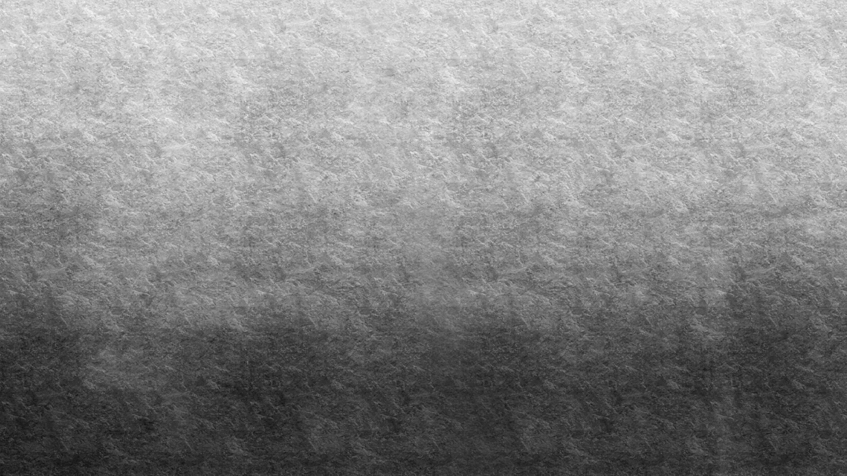

Introduction to Neural Networks
Arunabh Singh

Slide 2
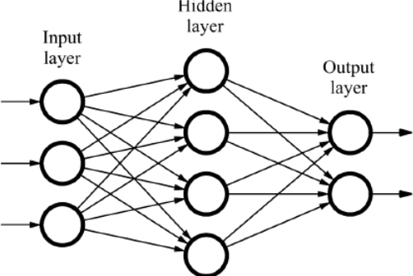
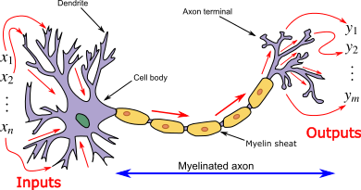
What is a Neural Network
It is an artificial network consisting of interconnected nodes which help find any complex relationship between Input and Target.
Neural networks are modelled or inspired by neurons of an actual brain.

Slide 3


Trivia on Founder
Hinton was co-author of a highly cited paper published in 1986 that popularized the backpropagation algorithm for training multi-layer neural networks, although his team was not the first to propose the approach.
Hinton is viewed by some as a leading figure in the deep learning community and is referred to by some as the "Godfather of Deep Learning

Slide 4
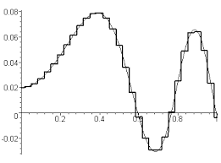
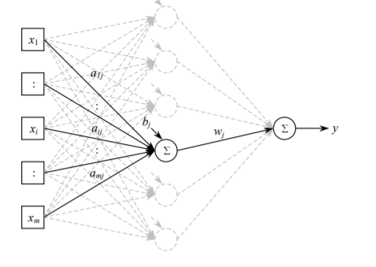
Why do we need a Neural Network?
Neural Networks can represent any function.
The universal approximation theorem claims that the standard multilayer feed-forward networks with a single hidden layer that contains finite number of hidden neurons, and with arbitrary activation function2 are universal approximators . (Source: Approximation with Artificial Neural Networks-Balázs Csanád Csáji,2001)
Universal Approximation using single hidden layer
(Source: Approximation with Artificial Neural Networks-Balázs Csanád Csáji,2001)

Slide 5
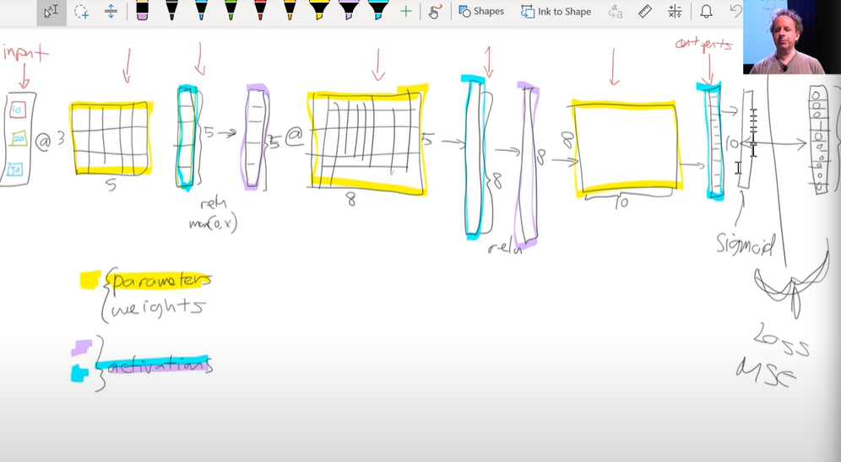
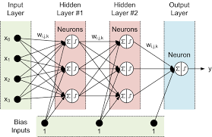
Visual Representation
Neural Network is a set of matrices multiplied with each other to get a final output matrix and elements of these matrices are fine tuned to get correct outputs.
For representation these are shown as nodes and layers as shown in the figure on the right.
Source: forexmt4indicators.com,2009, Author: Tim Morris
Source: course.fast.ai,2020, Author: Jeremy Howard

Slide 6
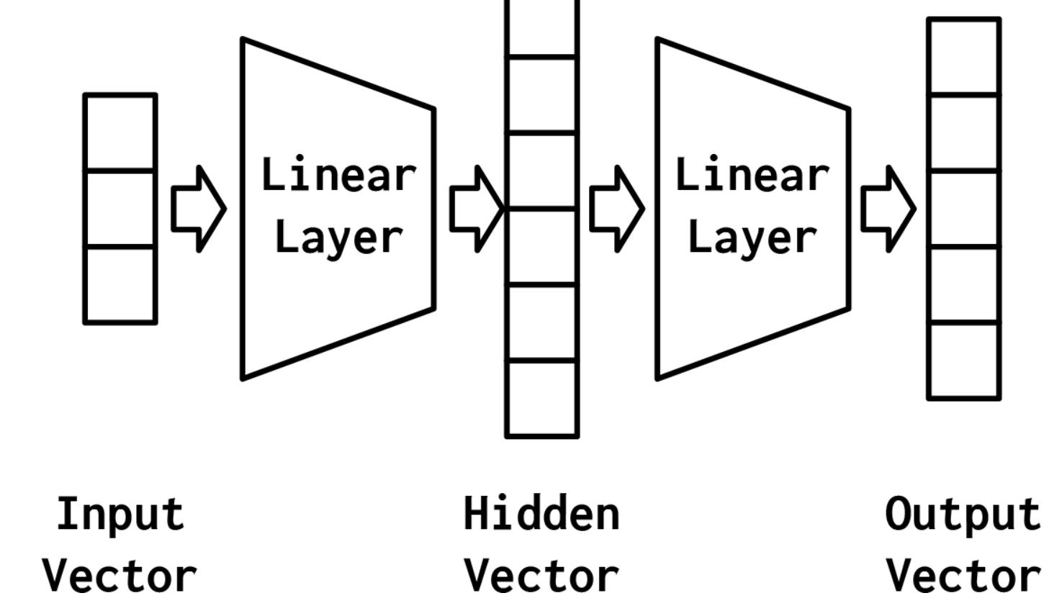
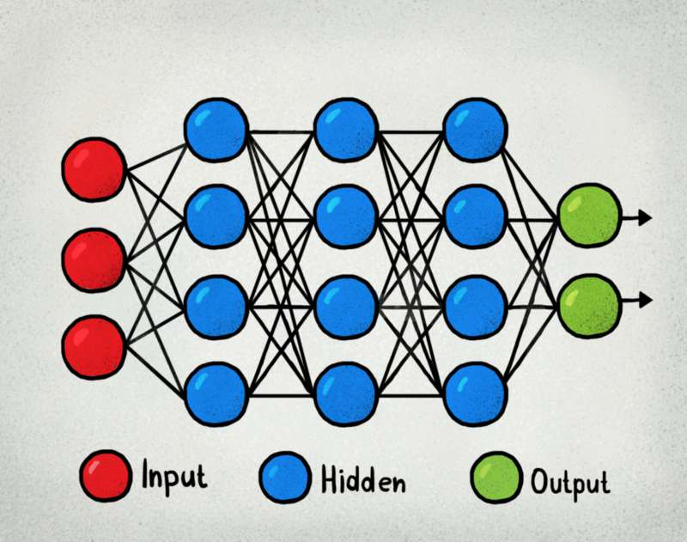
Deciding number of layers
There are certain customizations in a Neural Network a.k.a. Multilayer Perceptron or Fully Connected Network which need to be decided and user to try and test these to find best values for these.
These include the following: Number of Hidden Layers, Number of nodes in each of these hidden layers, the activation function and regularization technique to be used.
The more complex the network, the more time it takes to train it and more complex a pattern it can detect.
Source: Natural Language Processing with PyTorch by Delip Rao, Brian McMahan
Source: DataGraphi.com

Slide 7
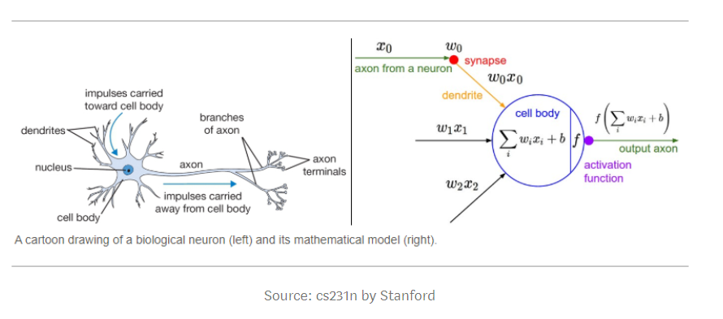
Activation Function
As we know neural networks are layers followed by each other till we get an output.
Each layer gets an input from previous layer in the form of: W1*X1+W2*X2+…..+WnXn
Now we know that this is a Linear Function and we need to complex representation. Also the range of this weights and input multiplication is between 0…A Very large Number. We want to change these properties to keep the Neural Network more generic and useful.
An activation function helps in doing this by acting as a transformer between every layer.
So every node in every layer has inputs from previous layer which are multiplied and summed and passed through an activation function like ReLU or Tanh before passing it to the next layer.

Slide 8
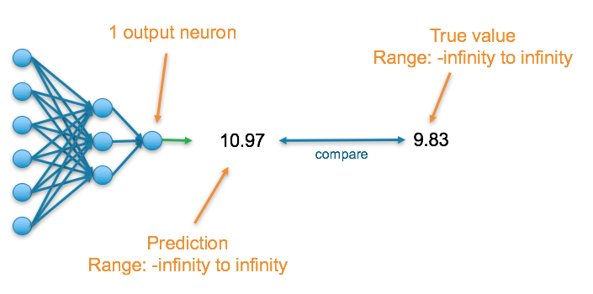
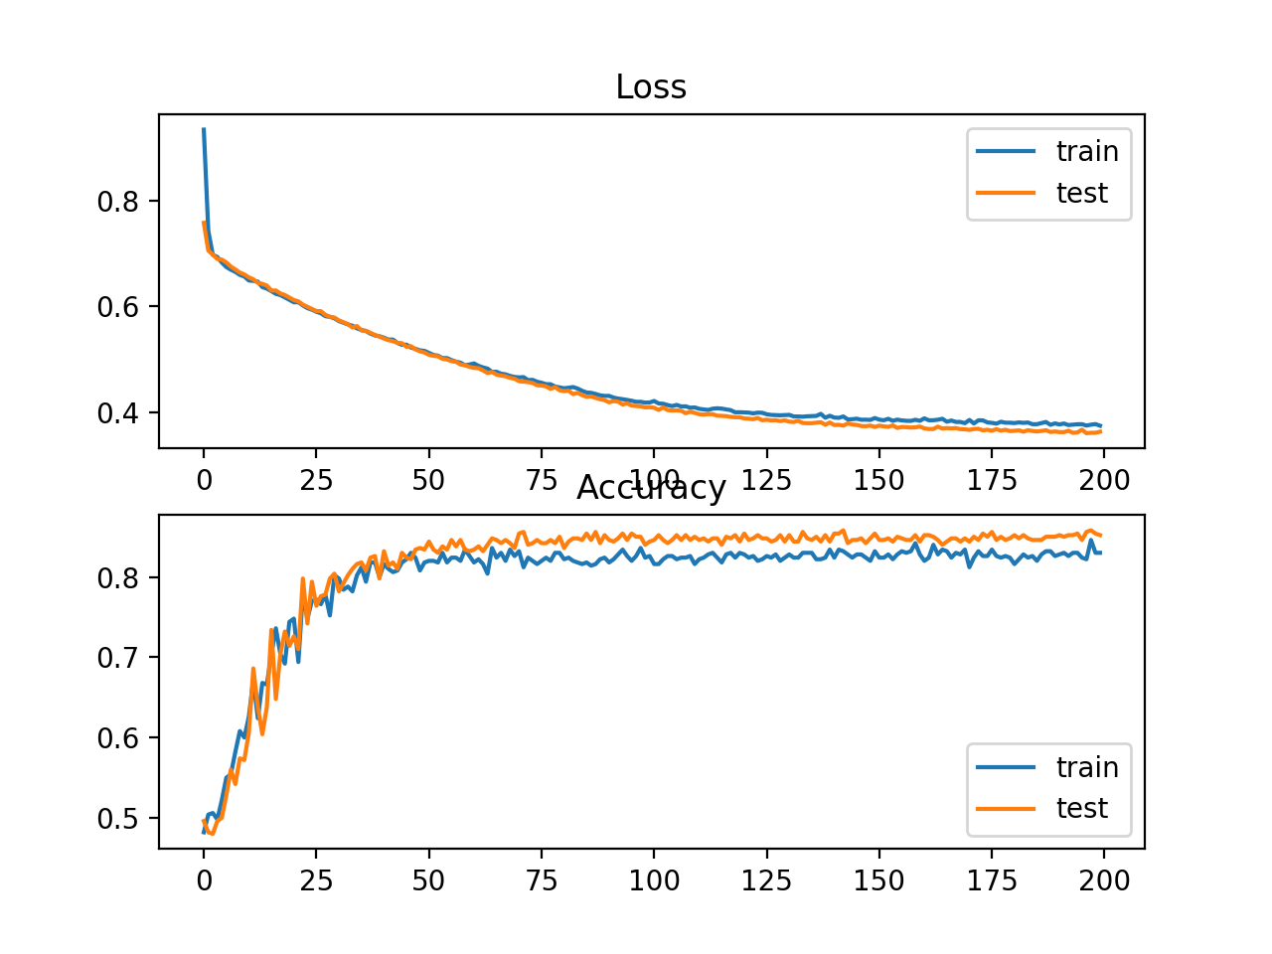
Loss Function
While you are training or initially when you have defined a Neural Network, it will not predict correctly.
There will be an error between the actual value and what your network is predicting. This difference is the loss function or error function.
We have to minimize this error over training to achieve the Network with weights that have been adjusted well enough to avoid any errors in final prediction.
As we can see in the right image, loss decreases with each training sample till it reduces and converges to a minimum.
Source: Towards Data Science, Stacy Ronaghan ,2018
Source: Machine Learning Mastery

Slide 9
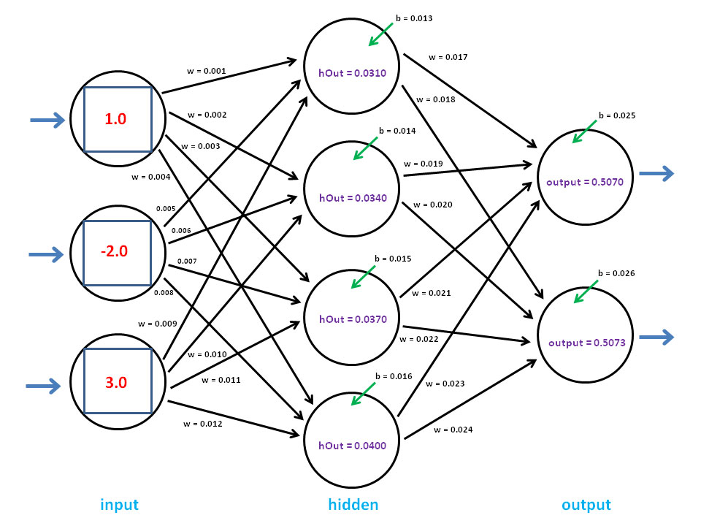
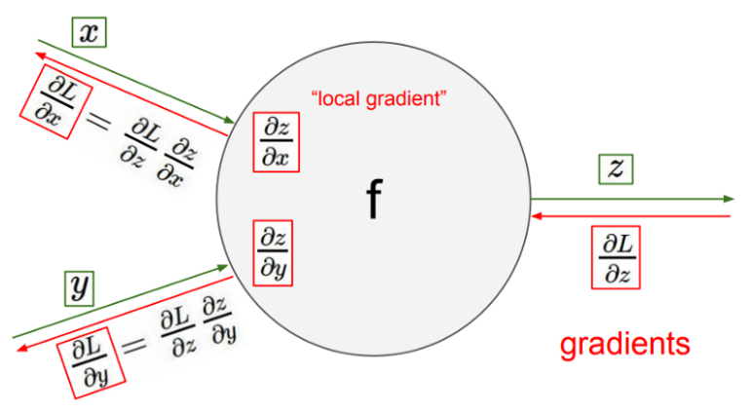
Backward Propagation
For error in output layer to reduce, we need to proportionately reduce error from every layer and node that exists in every layer.
Which means for every sample the incorrect error will send error as an electrical signal backwards to each node and will pass through the entire network backwards proportionately dividing between each node based on its contribution to the error and adjust its weight accordingly.
Source: Towards Data Science, Stacy Ronaghan ,2018

Slide 10
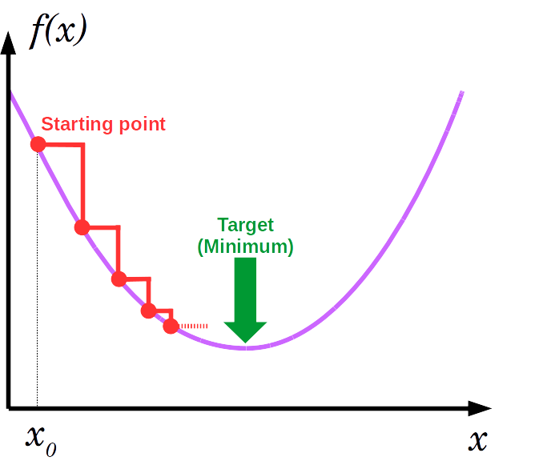
Gradient Descent
The gradient of derivative of loss function is the indication of how far it is form minimum.
Using this property we keep reducing the error by subtracting a gradient from error and propagating it back to all nodes.
We use a term a alpha*gradient which is subtracted after every sample or batch of samples from the weights across all layers and nodes proportionately.
Thus we have a technique to minimize the loss or error using mathematical optimization technique and alpha is multiplicative factor we can adjust to fine tune the descent or minimization of error.

Slide 11
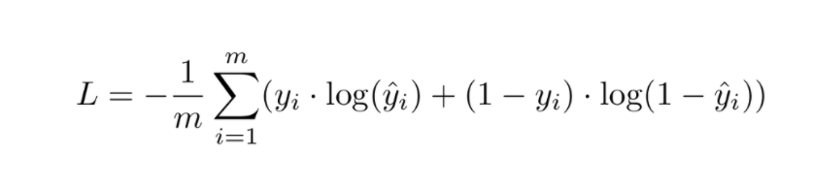
Cross Entropy Log-Loss
The math behind the function is skipped
But we will try to understand the intuition.
The output of softmax in final layer of Neural Network gives us a list of probabilities that add to 1.
We need to convert these probabilities to a set of 1 hot encoded vector of output classes.
This is achieved using a Cross Entropy Log Loss Function.
We wanted to define a continuous loss function as we take derivatives of our loss function and minimize it to get best weights for our Neural Network.
The above function achieves this.
When yi=1, first part of function is used and when yi=0, second part is used

Slide 12
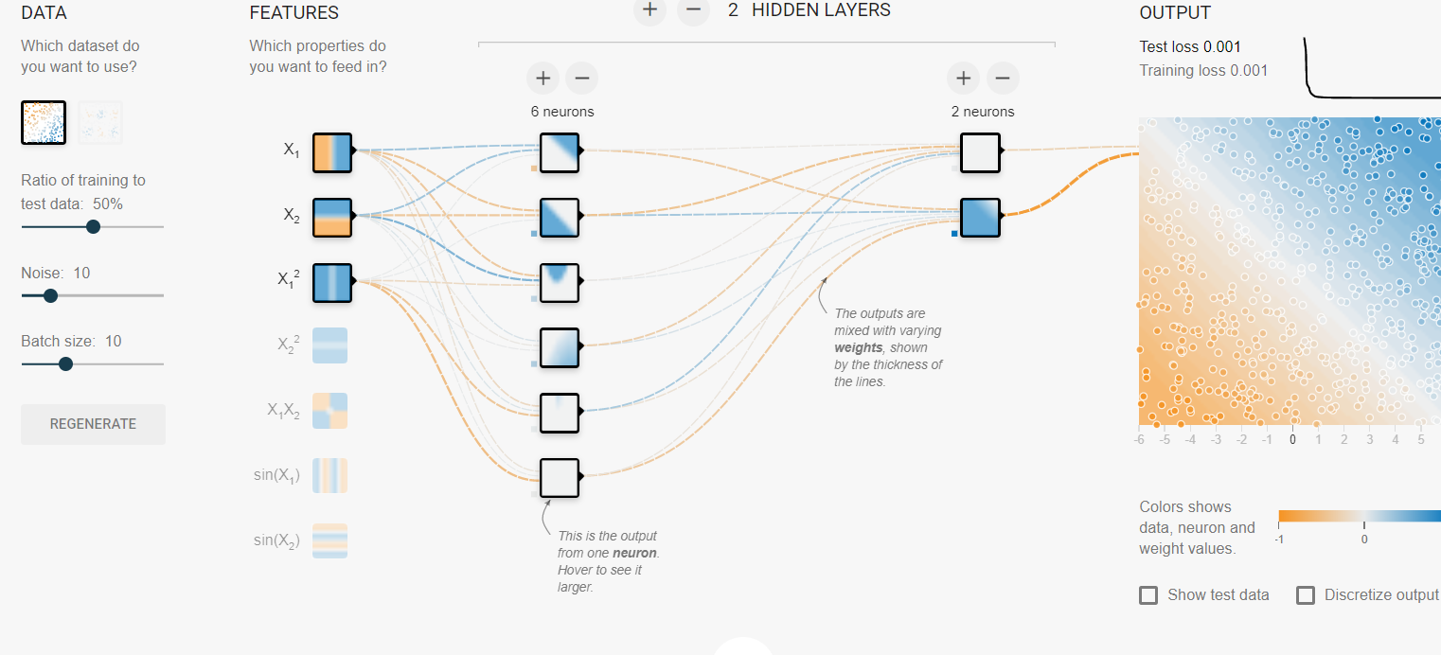
Activity
https://playground.tensorflow.org/ Use the visual tool to create dummy data with a noise percentage and design a Neural Network to reduce test loss to 0.005

Slide 13
Vanishing and Exploding Gradients

Slide 14
ADAM and RMSProp Optimization Algorithms

Slide 15
Thank You

